Slide 1
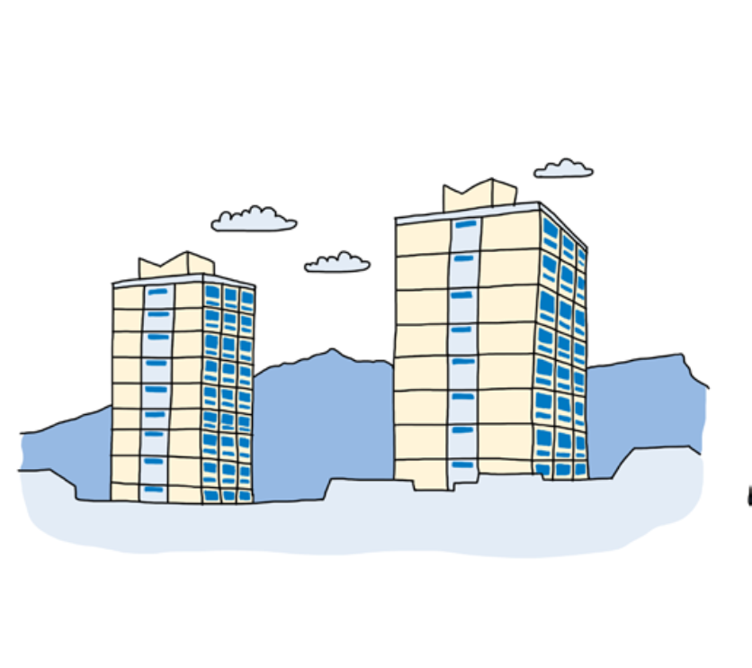
Housing Rights in Practice

Slide 2

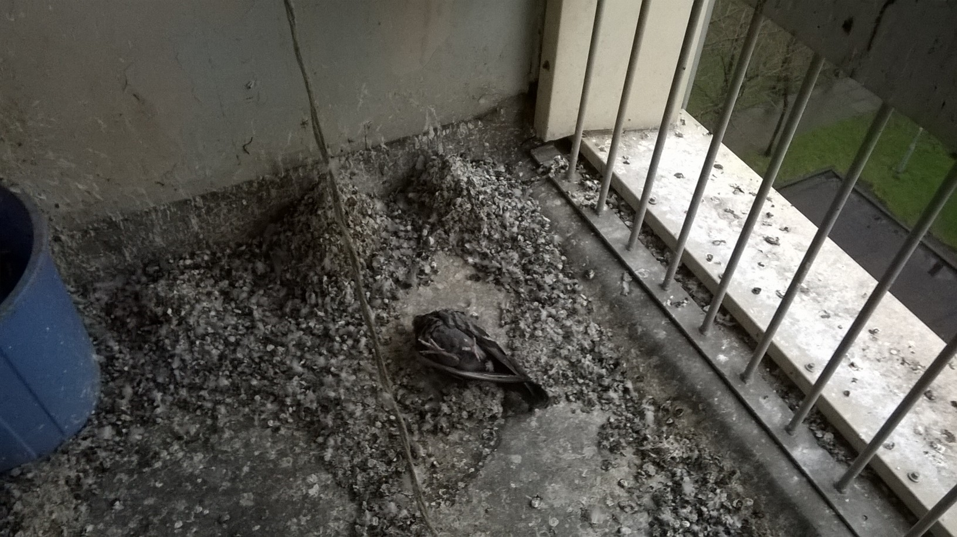

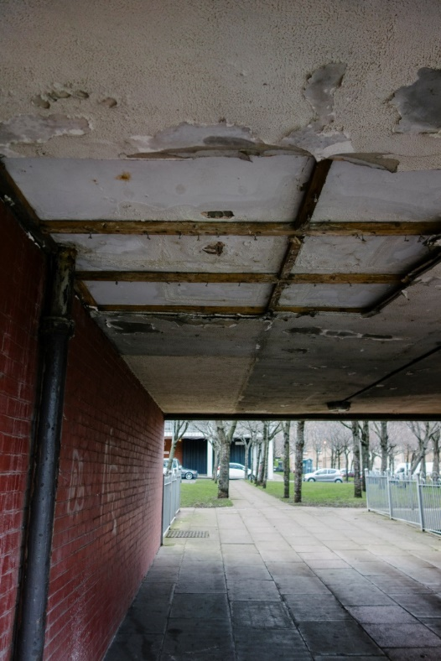

Living conditions

Slide 3
“I’m saying to myself – why is human rights getting involved in council housing?”
Resident, WPC

Slide 4
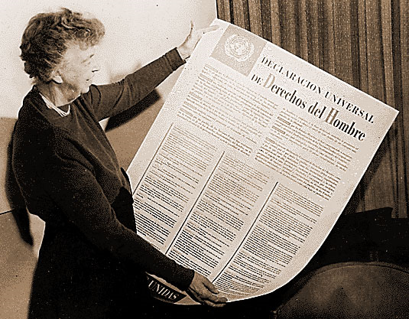
“Where, after all do universal human rights begin? In small places, close to home, so close and so small that they cannot be seen on any map of the world. Yet they are the world of the individual person: the neighbourhood he lives in; the school or college he attends; the factory, farm or office where he works…
Unless these rights have meaning there, they have little meaning anywhere.”
Eleanor Roosevelt

Slide 5


Slide 6
Economic, Social and Cultural Rights
International Covenant on Economic, Social and Cultural Rights
UK signed and ratified in 1976
Rights to health, social security, housing
Principles:
  Taking steps
  Progressive Realization
  Maximum of Available Resources
  Non-retrogression
General Comments

Slide 7

Right to Adequate Housing
Security of tenure
Habitable
Available Services
Location
Affordable
Accessible
Culturally appropriate

Slide 8
Principles of Human Rights Based Approaches
Participation
Accountability
Non-discrimination
Empowerment
Law

Slide 9



What we did
Participation and engagement to understand the issues people were facing.
Designed a survey to get more evidence
Undertook action research fieldwork – surveys, photos etc
Analysed results and reported back to community
Supported residents to frame issues with respect to human rights law
Supported residents to develop rights based indicators – 4 issues emerge strongly

Slide 10

Human Rights Based Indicators
Habitability/Available Services Element
Indicator 1 – Heating – an increase in the % of households who said their heating protected them from the cold
Habitability Element
Indicator 2 – Dampness – a reduction in the % of households experiencing dampness
Right to an Effective Remedy
Indicator 3 – Maintenance Response – an increase in % of households indicating they were satisfied with maintenance response
Participation and Transparency
Indicator 4 – Transparency and Participation – homeowners to receive quarterly, itemised bills

Slide 11

Public accountability meeting with Council
Walkabouts with political parties
Film shown at Scottish Parliament for Human Rights Day in December 2016
Media engagement
Regular meetings between Council and residents began in Jan 2017 and are ongoing
Council committed to works in Feb 2017
Works began in August 2017
Residents continue to monitor outcomes through action research

Slide 12
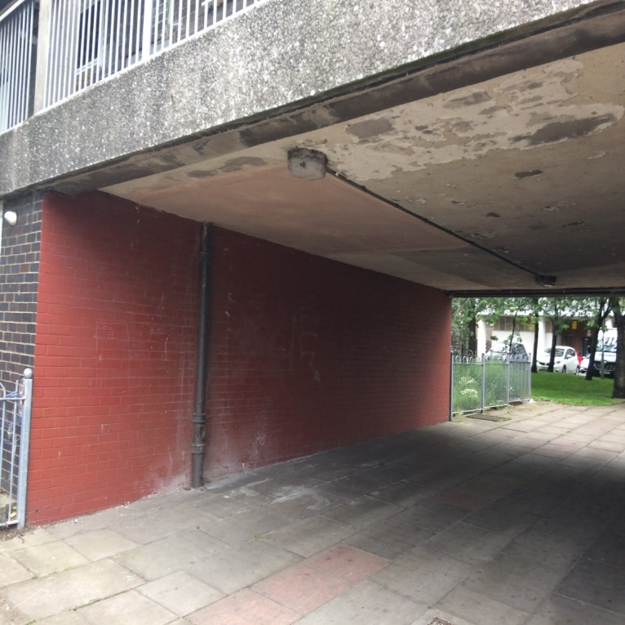
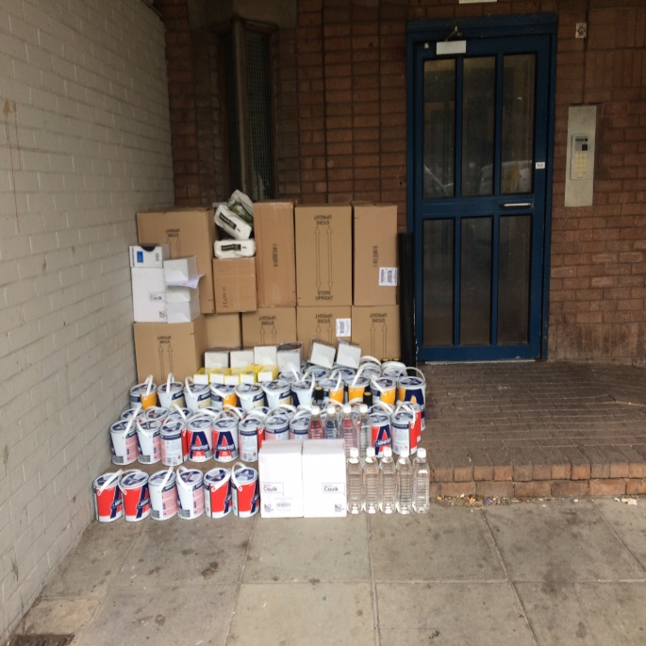
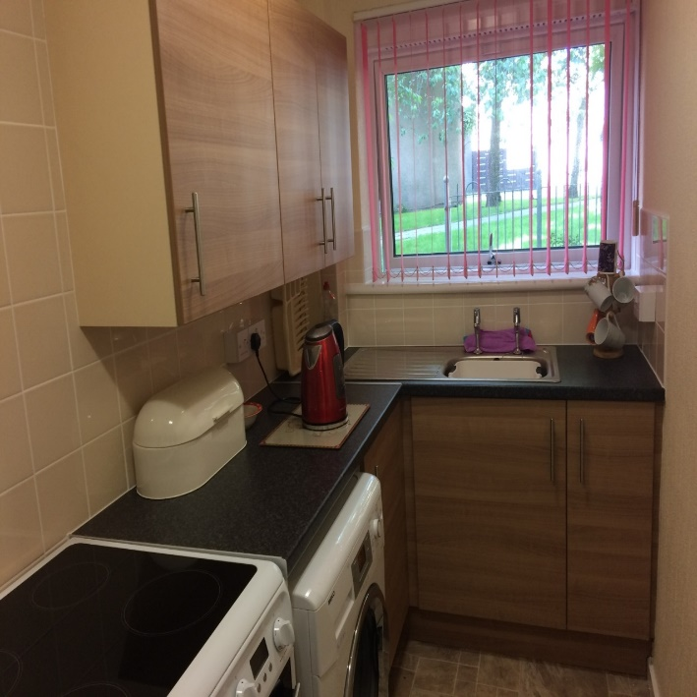
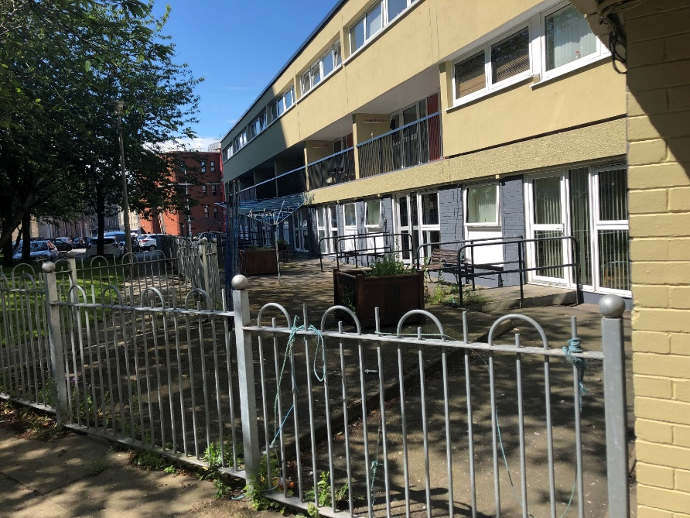

Slide 13


Results
Increase in % of households who say their heating protects them from the cold
Decrease in the % of households who experience dampness and mould
Reduction in the % of households reporting problems
In one building, continuing dissatisfaction with council responses to complaints. Homeowners still not happy with billing.

Slide 14



The ‘softer’ stuff…..
Half of respondents say that they cook more now than they did in their old kitchen.
One person reported having her family back for Christmas for the first time ever.
People report feeling more ‘hopeful’ and more confident.
People report that other residents are friendlier.

